Slide 1
ANOMALY DETECTION IN AUTONOMOUS VEHICLES USING EDGE DEVICE SENSORS
DOMAIN : AUTONOMOUS VEHICLES
Supervised by,
Dr. R. Gunasekaran
Professor Department of Computer Technology Anna University, MIT Campus
Presented by,
R. Sreenithi (Reg.no:2021614028) M.E. CSE Final Year Department of Computer Technology
Anna University, MIT Campus

Slide 2
OUTLINE:
Introduction
Literature survey
Existing challenges in Autonomous Vehicles
Problem statement
Objectives
References

Slide 3
INTRODUCTION
Autonomous vehicles, known as self-driving cars or driverless cars, uses Artificial Intelligence (AI), sensors, and communication systems for autonomous operation.
The benefits of AVs are to optimize traffic flow, reduce fuel consumption and lessen risk of accidents.
Autonomous vehicles can be categorized into five levels of automation:
Level 0: No automation
Level 1: Driver assistance – Adaptive Cruise Control (ACC), parking line detection, emergency braking and acceleration.
Level 2: Partial automation - The vehicle can control steering, acceleration, and braking, but the driver must remain alert and ready to take over if necessary.
Example: Tesla auto pilot
Level 3: Conditional automation - The vehicle can operate independently in some driving situations, but the driver must be ready to take over when alerted by the vehicle.
Example: Audi traffic jam pilot
Level 4: High automation - The vehicle can operate independently in most driving situations, but require a human driver in certain circumstances.
Example: Waymo firefly
Level 5: Full automation - The vehicle can operate independently in all driving situations without any human intervention.
Example: BMW I Next, Audi Alcon
Components of autonomous vehicles:
Sensors: cameras, radar, lidar, and ultrasonic sensors, which provide the vehicle with a detailed view of its surroundings.
Control systems: to make decisions about how to navigate their environment.
Communication systems: to exchange information with other vehicles and infrastructure, such as traffic lights and road signs.
Mapping technology: maps allow the vehicle to understand the road network, including lane markings, road signs, and speed limits.
Actuators: variety of actuators, including motors and brakes, which allow the vehicle to accelerate, decelerate, and steer.
Computing systems: powerful processors and graphics cards, to process the data from the sensors and make decisions.

Slide 4
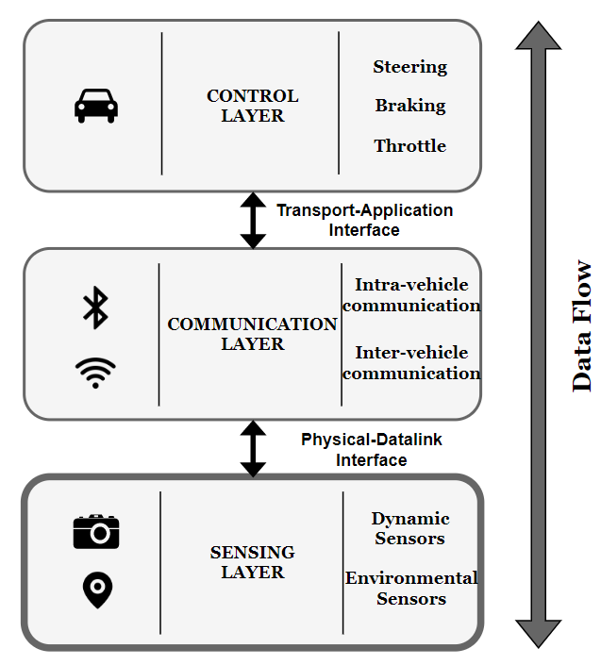
Three-tier Connected and Automated Vehicle Architecture

Slide 5
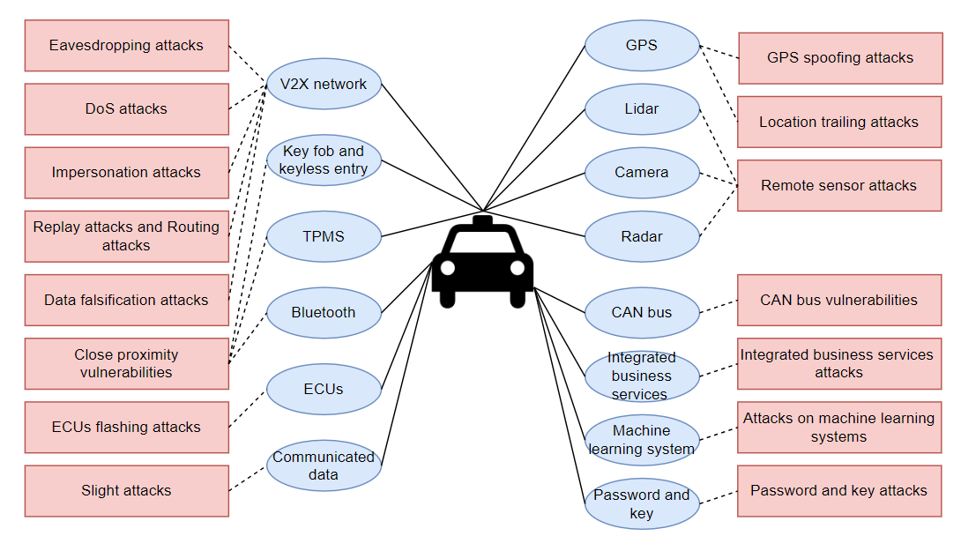
ATTACKS ON AV COMPONENTS

Slide 6
LITERATURE SURVEY
SNO | TITLE OF THE PAPER | NAME OF THE JOURNAL AND PUBLISHED YEAR | PROPOSED WORK | PROPOSED METHODOLOGY/ALGORITHM | LIMITATIONS
1 | Detecting Vehicle Anomaly in the Edge via Sensor Consistency and Frequency Characteristic | IEEE TRANSACTIONS ON VEHICULAR TECHNOLOGY, VOL. 68, NO. 6, JUNE 2019 | A novel edge computing based anomaly detection, coined Edge computing based Vehicle Anomaly Detection (EVAD), which exploits edge based sensor data fusion to identify the anomaly events | Edge computing based vehicle anomaly detection (EVAD) algorithm, time and frequency domain property | The effect of frequency domain analysis is less useful for the anomaly detection to the nodes, which consist of more than one sensors
2 | A Fault Detection and Diagnosis System for Autonomous Vehicles Based on Hybrid Approaches | IEEE SENSORS JOURNAL, VOL. 20, NO. 16, AUGUST 15, 2020 | An accurate fault detection and diagnosis system to prevent the potential hazardous situations | First, to detect the state faults of the autonomous vehicle, Support Vector Machine (SVM) method is adopted to train the boundary curve which separates the safe domain and unsafe domain, a Kalman filter observer is designed to predict the current position of the vehicle | Type of the subsystem causes the fault
3 | A Fast Anomaly Diagnosis Approach Based on Modified CNN and Multisensor Data Fusion | IEEE TRANSACTIONS ON INDUSTRIAL ELECTRONICS, VOL. 69, NO. 12, DECEMBER 2022 | A modified convolutional neural network (CNN) algorithm, namely 1D-GAPCNN-SVM, is proposed to address the early anomaly diagnosis problem. | To reduce the number of parameters, a 1-D global average pooling layer is designed to substitute the fully connected layer with two or three layers. In order to further improve the diagnosis accuracy, a nonlinear multiclass support vector machine (SVM) is adopted to replace the traditional Softmax classifier as the final discriminator | 2D-model with inefficient multisensor data fusion

Slide 7
SNO | TITLE OF THE PAPER | NAME OF THE JOURNAL AND PUBLISHED YEAR | PROPOSED WORK | PROPOSED METHODOLOGY/ALGORITHM | LIMITATIONS
4 | A Sensor Fusion-Based GNSS Spoofing Attack Detection Framework for Autonomous Vehicles | IEEE TRANSACTIONS ON INTELLIGENT TRANSPORTATION SYSTEMS, VOL. 23, NO. 12, DECEMBER 2022 | A sensor fusion-based Global Navigation Satellite System (GNSS) spoofing attack detection framework for autonomous vehicles (AVs) of two strategies: (i) comparison between predicted location shifts and motion stated and (ii) detection and classification of turns (left or right) | Data from low-cost in-vehicle inertial sensors—i.e., speedometer, accelerometer fed to a long short-term memory (LSTM) to predict the distance between two consecutive timestamps and next combines k-Nearest Neighbors (k-NN) and Dynamic Time Warping (DTW) algorithms to detect a turn and then classify left and right turns using steering angle sensor output | Robust anti-spoofing technologies to mitigate spoofing attacks on GNSS receivers
5 | CANnolo: An Anomaly Detection System Based on LSTM Autoencoders for Controller Area Network | IEEE TRANSACTIONS ON NETWORK AND SERVICE MANAGEMENT, VOL. 18, NO. 2, JUNE 2021 | CANnolo, an IDS based on Long Short-Term Memory (LSTM)- autoencoders to identify anomalies in Controller Area Networks (CANs) | CANnolo automatically analyzes the CAN streams and builds a model of data sequences and detects anomalies by computing the difference between the reconstructed and the respective real sequences. | Different data over time series makes it relatively slow computation
6 | A Unified Bayesian Framework for Joint Estimation and Anomaly Detection in Environmental Sensor Networks | IEEE ACCESS ,DEC 2022 | A novel unified Bayesian framework that enable simultaneous estimation of a common parameter of interest and identification of multiple and possibly different types of anomalies that can affect sensors in environmental sensor networks | The optimal joint maximum-likelihood and maximum a-posteriori (ML-MAP) estimation method, and propose novel reduced-complexity two-step algorithms able to achieve almost the same performance of the joint ML-MAP, but at a fraction of its computational cost | Computational complexity in cost analysis, to increase the percent of faulty nodes in network

Slide 8
SNO | TITLE OF THE PAPER | NAME OF THE JOURNAL AND PUBLISHED YEAR | PROPOSED WORK | PROPOSED METHODOLOGY/ALGORITHM | LIMITATIONS
7 | Filter-Based Secure Dynamic Pose Estimation for Autonomous Vehicles | IEEE SENSORS JOURNAL, VOL. 19, NO. 15, AUGUST 1, 2019 | recursive secure dynamic estimator has been designed to tackle the state estimation problem for autonomous vehicles in the circumstance of possible sensor attacks | Proposed estimator coincides with the conventional Kalman filter when all sensors on autonomous vehicles are benign | -Pose estimation when sensors fail
8 | Learning-Based Attacks in Cyber-Physical Systems | IEEE TRANSACTIONS ON CONTROL OF NETWORK SYSTEMS, VOL. 8, NO. 1, MARCH 2021 | an arbitrary learning algorithm to estimate the system dynamic | The controller improves the security imposing crafted privacy-enhancing signal on top of the “nominal control policy.” | -Controller does not know the exact time instant at which an attack might occur as in non-linear system
9 | “Seeing is Not Always Believing”: Detecting Perception Error Attacks Against Autonomous Vehicles | IEEE TRANSACTIONS ON DEPENDABLE AND SECURE COMPUTING, VOL. 18, NO. 5, SEPTEMBER/OCTOBER 2021 | the impact of perception error attacks (PEAs) on autonomous vehicles, and propose a countermeasure called LIFE (LIDAR and Image data Fusion for detecting perception Errors) | The impact of perception error attacks (PEAs) on autonomous vehicles, and propose a countermeasure called LIFE (LIDAR and Image data Fusion for detecting perception Errors) | -Lack of data, with good weather and excellent field of view to driver
10 | Toward Interpretability in Fault Diagnosis for Autonomous Vehicles: Interpretation of Sensor Data Anomalies | IEEE SENSORS JOURNAL, VOL. 23, NO. 5, 1 MARCH 2023 | Environmental impact is first evaluated using the noise energy as a measure to interpret the impact on sensor data caused by the environment | Savitzky–Golay filters are applied for online denoising, acting as a countermeasure to mitigate the impact and to enhance the data quality. Then, the adversarial learned denoising shrinkage autoencoder (ALDSAE), an adversarial learning neural network, is constructed for sensor data anomaly detection.. | -Fault interpretation in Avs are complex to compute

Slide 9
EXISTING CHALLENGES IN AUTONOMOUS VEHICLES
It is a challenge to distinguish between intentional and unintentional interference in spoofing attacks.
Pose estimation is a critical problem in autonomous vehicle navigation, especially in circumstances where sensor failure or attacks exist.
An accurate fault detection and diagnosis system is of great importance for autonomous vehicles to prevent the potential hazardous situations.
Modern vehicles are vulnerable to multiple types of attacks leveraging remote, direct and indirect physical access, which allow attackers to gain control and affect safety-critical systems.

Slide 10
PROBLEM STATEMENT
Autonomous vehicles rely on various sensors, software, and hardware sensor components to navigate and make decisions.
The correlation between vehicles and its parameters in autonomous vehicles helps to identify and analyze anomaly in edge sensor data values.
The proposing Autonomous Lane Speed Detection system helps to optimize the performance of the autonomous system, reduce errors, and improve safety by analyzing the vehicle speed with its GPS and Lane speed limit.

Slide 11
OBJECTIVES
To understand how different vehicle parameters interact with each other and impact the overall performance of the autonomous system.
To identify the correlation of the lane speed limits with vehicle speed and GPS speed is evaluated to find the anomaly in vehicles using Autonomous Lane Speed Detection System (ALSD).

Slide 12
REFERENCES
W. Gong, Y. Wang, M. Zhang, E. Mihankhah, H. Chen and D. Wang, "A Fast Anomaly Diagnosis Approach Based on Modified CNN and Multisensor Data Fusion," in IEEE Transactions on Industrial Electronics, vol. 69, no. 12, pp. 13636-13646, Dec. 2022.
Y. Fang, H. Min, W. Wang, Z. Xu and X. Zhao, "A Fault Detection and Diagnosis System for Autonomous Vehicles Based on Hybrid Approaches," in IEEE Sensors Journal, vol. 20, no. 16, pp. 9359-9371, 15 Aug.15, 2020.
S. Dasgupta, M. Rahman, M. Islam and M. Chowdhury, "A Sensor Fusion-Based GNSS Spoofing Attack Detection Framework for Autonomous Vehicles," in IEEE Transactions on Intelligent Transportation Systems, vol. 23, no. 12, pp. 23559-23572, Dec. 2022, doi: 10.1109/TITS.2022.3197817.
A. Fascista, A. Coluccia and C. Ravazzi, "A Unified Bayesian Framework for Joint Estimation and Anomaly Detection in Environmental Sensor Networks," in IEEE Access, vol. 11, pp. 227-248, 2023.
S. Longari, D. H. Nova Valcarcel, M. Zago, M. Carminati and S. Zanero, "CANnolo: An Anomaly Detection System Based on LSTM Autoencoders for Controller Area Network," in IEEE Transactions on Network and Service Management, vol. 18, no. 2, pp. 1913-1924, June 2021.
F. Guo et al., "Detecting Vehicle Anomaly in the Edge via Sensor Consistency and Frequency Characteristic," in IEEE Transactions on Vehicular Technology, vol. 68, no. 6, pp. 5618-5628, June 2019.
X. Liu, R. Jiang, H. Wang and S. S. Ge, "Filter-Based Secure Dynamic Pose Estimation for Autonomous Vehicles," in IEEE Sensors Journal, vol. 19, no. 15, pp. 6298-6308, 1 Aug.1, 2019.
M. J. Khojasteh, A. Khina, M. Franceschetti and T. Javidi, "Learning-Based Attacks in Cyber-Physical Systems," in IEEE Transactions on Control of Network Systems, vol. 8, no. 1, pp. 437-449, March 2021.
J. Liu and J. -M. Park, "“Seeing is Not Always Believing”: Detecting Perception Error Attacks Against Autonomous Vehicles," in IEEE Transactions on Dependable and Secure Computing, vol. 18, no. 5, pp. 2209-2223, 1 Sept.-Oct. 2021.
J. Liu and J. -M. Park, "“Seeing is Not Always Believing”: Detecting Perception Error Attacks Against Autonomous Vehicles," in IEEE Transactions on Dependable and Secure Computing, vol. 18, no. 5, pp. 2209-2223, 1 Sept.-Oct. 2021.

Slide 13
THANK YOU

